Slide 1
Pattern Recognition
Imran Siddiqi
imran.siddiqi@mcs.edu.pk
Notes:
Good Morning! My name is Chao.
Today I like to give a topic on “Content-Based Retrieval” which so called “CBR” in multimedia systems.

Slide 2
Contents
Introduction to Patterns and Pattern Recognition
Clustering vs. Classification
Template Matching
Features
Classification

Slide 3
Features
Features are the individual measurable properties of the signal being observed.
The set of features used for pattern recognition is called feature vector.
The number of used features is the dimensionality of the feature vector.
n-dimensional feature vectors can be represented as points in n-dimensional feature space

Slide 4
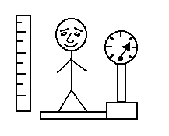
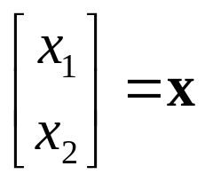
Features
height
weight
Class 1
Class 1
Class 2
Class 2

Slide 5
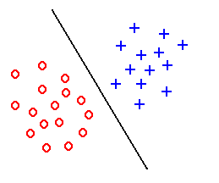
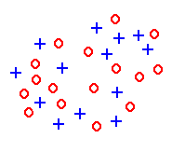
Features
Feature extraction aims to create discriminative features good for classification
Good Features
Objects from the same class have similar feature values.
Objects from different classes have different values.
“Good” features
“Bad” features

Slide 6
Features
Use fewer features if possible
Use features that differentiate classes well
Character recognition example
  Good features: aspect ratio, presence of loops
  Bad features: number of black pixels, number of connected components

Slide 7
Classifier
Identify the class of a given pattern

Slide 8
Classifier
Distance between Feature Vectors
Instead of finding template exactly matching input template look at how close feature vectors are
Nearest neighbor classification algorithm:
  Find template closest to the input pattern.
  Classify pattern to the same class as closest template.
Class 1
Class 2

Slide 9
Classifier
K-Nearest Neighbor Classifier
Use k nearest neighbors instead of 1 to classify pattern.
Class 1
Class 2

Slide 10
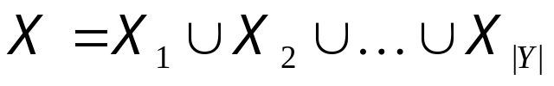

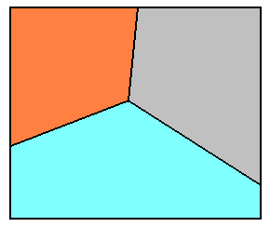
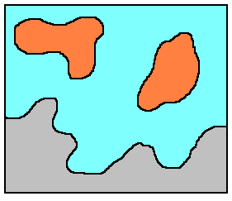

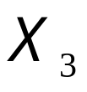
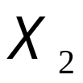
Classifier
A classifier partitions feature space X into class-labeled regions such that:
and
The classification consists of determining to which region a feature vector x belongs to.
Borders between regions are called decision boundaries

Slide 11


A (Simplified )PR System
Two Modes:
Classification Mode
test
pattern
Preprocessing
Feature
Measurement
Classification
Feature
Extraction/
Selection
training
pattern
Preprocessing
Learning
Training Mode

Slide 12
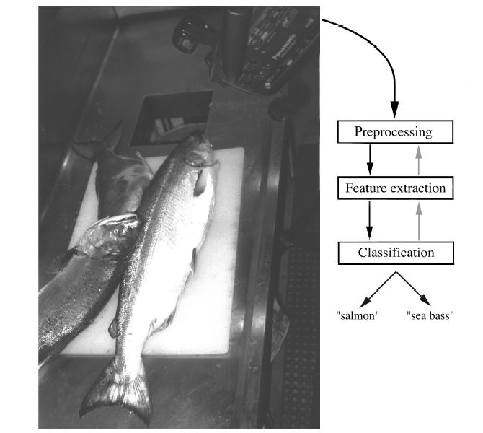
Classification - Example
Sorting incoming Fish on a conveyor according to species using optical sensing
Salmon or Sea Bass?

Slide 13
Classification - Example
Set up a camera and take some sample images to extract features
  Length
  Lightness
  Width
  Number and shape of fins
  Position of the mouth, etc…

Slide 14
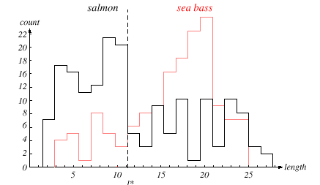
Classification - Example

Slide 15
Classification - Example
The length is a poor feature alone!
Select the lightness as a possible feature.

Slide 16
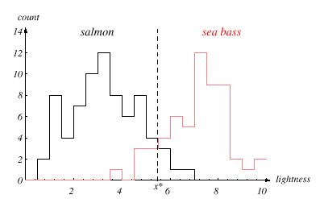
Classification - Example

Slide 17
Classification - Example
Customers do not want sea bass in their cans of salmon

Slide 18
Classification - Example
Decision boundary threshold and cost relationship
Move our decision boundary toward smaller values of lightness in order to minimize the cost (reduce the number of sea bass that are classified salmon!)

Slide 19
Classification - Example
x = [x₁, x₂]
FISH
Lightness
Width

Slide 20
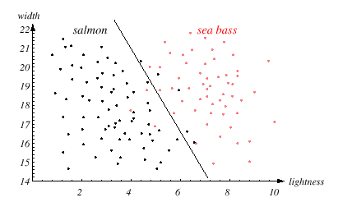
Classification - Example

Slide 21
Classification - Example
We might add other features that are not correlated with the ones we already have. A precaution should be taken not to reduce the performance by adding such “noisy features”
Ideally, the best decision boundary should be the one which provides an optimal performance

Slide 22
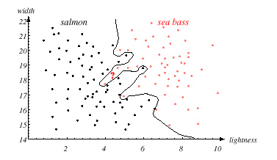
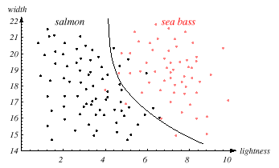
Classification - Example
Generalization?

Slide 23
References
  Graphical Models in Document Image Analysis - Venu Govindaraju, CEDAR
  Classification of Handwritings in the Perspective of Writer Recognition – PhD Thesis, I. Siddiqi, 2009
  Statistical Pattern Recognition: A Review – A.K Jain et al., PAMI (22) 2000
  Pattern Recognition and Analysis Course – A.K. Jain, MSU
  Introduction to Pattern Recognition -Vojtěch Franc, Czech Technical University in Prague
  Pattern Classification” by Duda et al., John Wiley & Sons.

